Slide 1
Skip Lists
S₃
−∞
+∞
S₂
−∞
15
+∞
S₁
−∞
15
23
+∞
S₀
−∞
10
15
23
36
+∞

Slide 2

Flight Databases
Key: (origin, destination, date, time)
Value: (flight number, available seats, first or economy, duration, fare, etc
User
Happy about “closest” departure time, not simply searching the flights with exact match with the given key
We may need a slightly different data structure from Map ADT
That’s an ordered Map

Slide 3
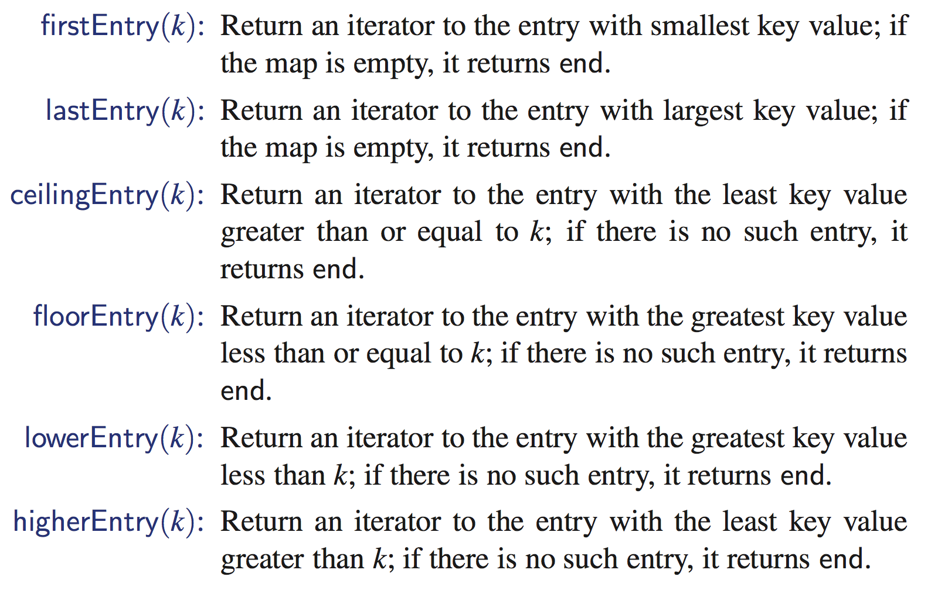
Ordered Map ADT
Map ADT + the following methods
SkipList is one of the efficient way of implementing ordered Maps

Slide 4
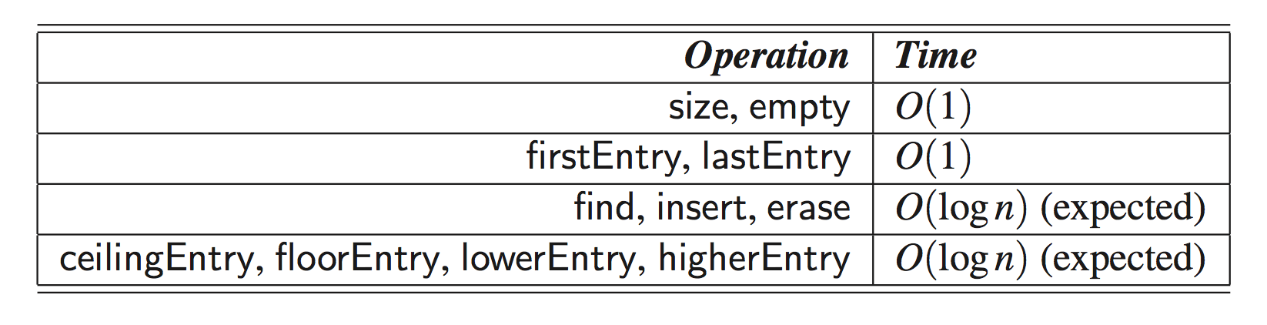
Implementing Ordered Map
Natural choice
Sorted list based implementation
O(n) searching, insertion, deletion complexity
Lesson from HashTable
Unordered map can be implemented by O(1) time (on average)
Can we imagine similar things for ordered map?
SkipList

Slide 5
What is a Skip List
A skip list for a set S of distinct (key, element) items is a series of lists S₀, S₁ , … , S_{h} such that
Each list S_{i} contains the special keys +∞ and −∞
List S₀ contains the keys of S in nondecreasing order
Each list is a subsequence of the previous one, i.e., S₀ ⊇ S₁ ⊇ … ⊇ S_{h}
List S_{h} contains only the two special keys
We show how to use a skip list to implement the ordered MAP ADT
S₃
−∞
+∞
S₂
−∞
31
+∞
S₁
−∞
23
31
34
64
+∞
S₀
−∞
12
23
26
31
34
44
56
64
78
+∞

Slide 6
Search
We search for a key x in a a skip list as follows:
We start at the first position of the top list
At the current position p, we compare x with y ← key(next(p))
x = y: we return element(next(p))
x > y: we “scan forward”
x < y: we “drop down”
If we try to drop down past the bottom list, we return null
Example: search for 78
S₃
−∞
+∞
scan forward
S₂
−∞
31
+∞
drop down
S₁
−∞
23
31
34
64
+∞
S₀
−∞
12
23
26
31
34
44
56
64
78
+∞

Slide 7
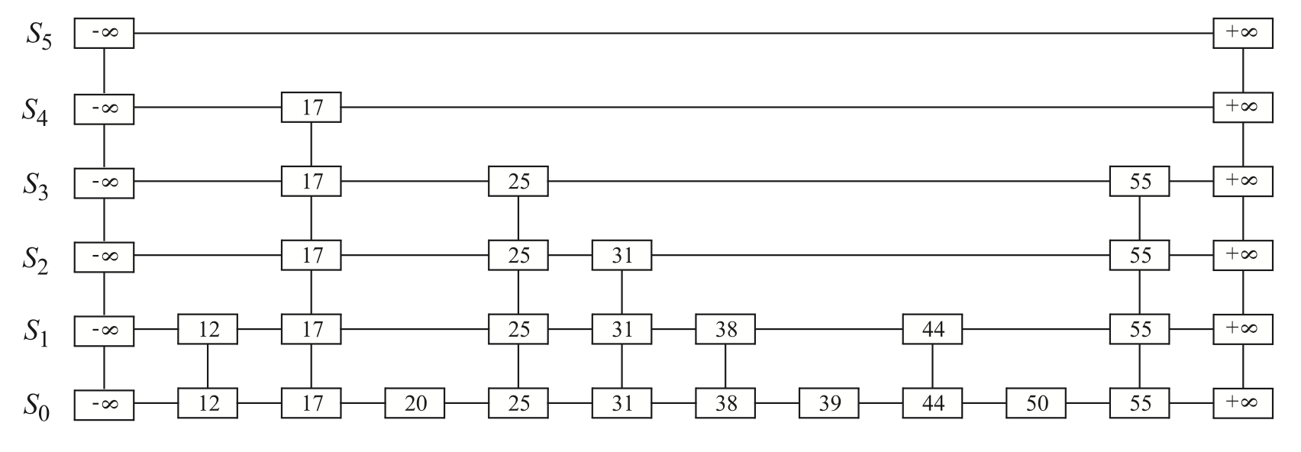
Terminology
Height = 5
Level
(similar to “row”)
Tower (similar to “column”)

Slide 8
(Note) Randomized Algorithms
A randomized algorithm performs coin tosses (i.e., uses random bits) to control its execution
It contains statements of the type
b ← random()
if b = 0
do A …
else { b = 1}
do B …
Its running time depends on the outcomes of the coin tosses
We analyze the expected running time of a randomized algorithm under the following assumptions
the coins are unbiased, and
the coin tosses are independent
The worst-case running time of a randomized algorithm is often large but has very low probability (e.g., it occurs when all the coin tosses give “heads”)
We use a randomized algorithm to insert items into a skip list

Slide 9
Insertion
To insert an entry (x, o) into a skip list, we use a randomized algorithm:
We repeatedly toss a coin until we get tails, and we denote with i the number of times the coin came up heads
If i ≥ h, we add (to the skip list) new lists S_{h+1}, … , S_{i +1}, each containing only the two special keys, and do nothing, otherwise
We search for x in the skip list and find the positions p₀, p₁ , …, p_{i} of the items with largest key less than x in each list S₀, S₁, … , S_{i}
For j ← 0, …, i, we insert item (x, o) into list S_{j} after position p_{j}
Example: insert key 15, with i = 2
S₃
−∞
+∞
p₂
S₂
−∞
+∞
S₂
−∞
15
+∞
p₁
S₁
−∞
23
+∞
S₁
−∞
15
23
+∞
p₀
S₀
−∞
10
23
36
+∞
S₀
−∞
10
15
23
36
+∞

Slide 10
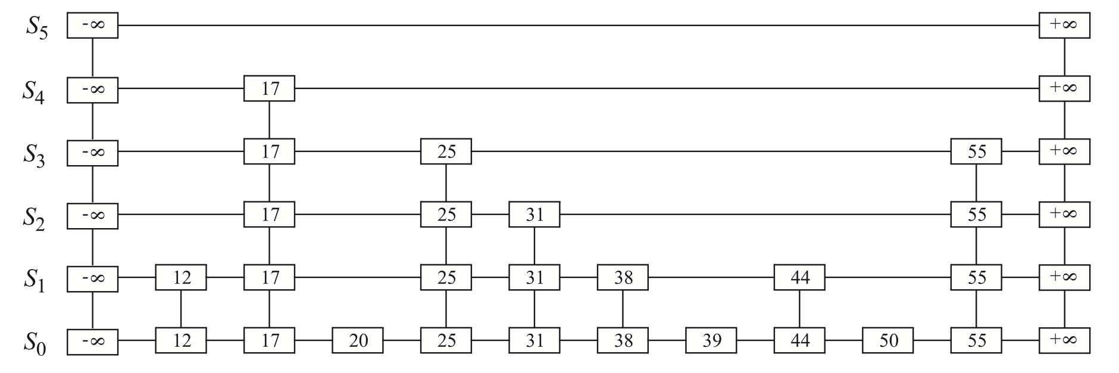
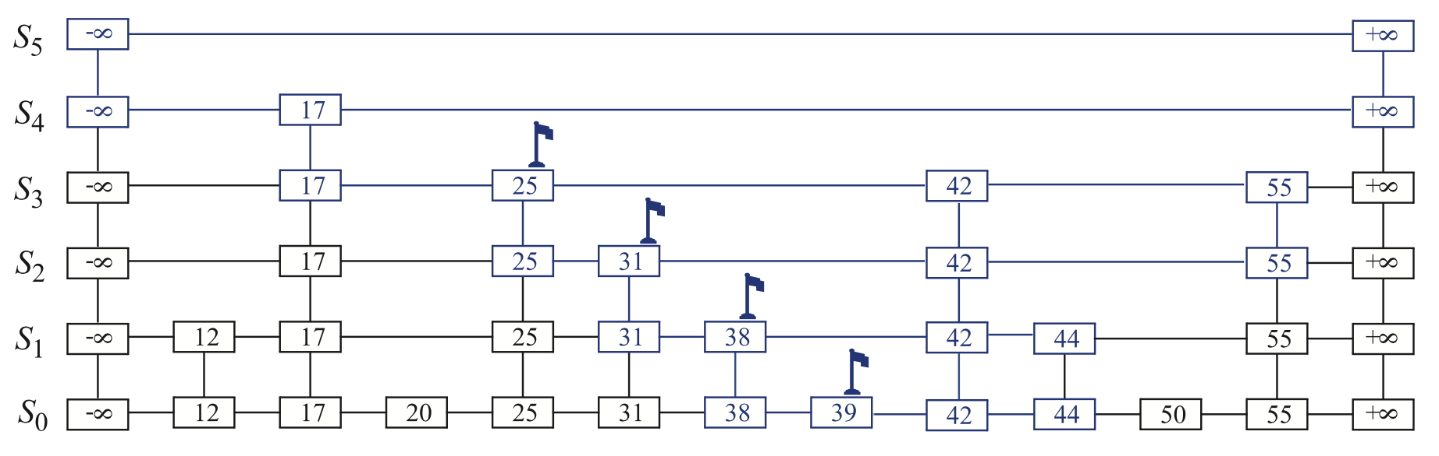
Example of Insertion of Key “42” with i = 3
p₃
p₂
p₁
p₀

Slide 11
Deletion
To remove an entry with key x from a skip list, we proceed:
We search for x in the skip list and find the positions p₀, p₁ , …, p_{i} of the items with key x, where position p_{j} is in list S_{j}
We remove positions p₀, p₁ , …, p_{i} from the lists S₀, S₁, … , S_{i}
We remove all but one list containing only the two special keys
Example: remove key 34
S₃
−∞
+∞
p₂
S₂
−∞
34
+∞
S₂
−∞
+∞
p₁
S₁
−∞
23
34
+∞
S₁
−∞
23
+∞
p₀
S₀
−∞
12
23
34
45
+∞
S₀
−∞
12
23
45
+∞

Slide 12
Implementation
We can implement a skip list with quad-nodes
A quad-node stores:
entry
link to the node prev
link to the node next
link to the node below
link to the node above
Also, we define special keys PLUS_INF and MINUS_INF, and we modify the key comparator to handle them
quad-node
x

Slide 13
Performance of skiplist
Space
O(n)
Surprising? (Note that an element is stored in multiple places)
Time
You will see why the probability course helps here. Be ready for math

Slide 14
Space Usage
The space used by a skip list depends on the random bits used by each invocation of the insertion algorithm
We use the following two basic probabilistic facts:
Fact 1: The probability of getting i consecutive heads when flipping a coin is 1/2^{i}
Fact 2: If each of n entries is present in a set with probability p, the expected size of the set is np (expectation of a binomial distribution)
Consider a skip list with n entries
By Fact 1, we insert an entry in list S_{i} with probability 1/2^{i}
Why? Because we insert the entry for all levels <= i
By Fact 2, the expected size of list S_{i} is n/2^{i}
The expected number of nodes used by the skip list is
Thus, the expected space usage of a skip list with n items is O(n)

Slide 15
Height
The running time of the search and insertion algorithms is affected by the height h of the skip list
We show that with high probability, a skip list with n items has height O(log n)
We use the following additional probabilistic fact:
Fact 3: If each of n events has probability p, the probability that at least one event occurs is at most np (union bound)
Consider a skip list with n entires
By Fact 1, we insert an entry in list S_{i} with probability 1/2^{i}
By Fact 3, the probability that list S_{i} has at least one item is at most n/2^{i}
By picking i = 3log n, we have that the probability that S_{3log n} has at least one entry is at most n/2^{3log n} = n/n³ = 1/n²
Thus a skip list with n entries has height at most 3log n with probability at least 1 − 1/n²
The height is O(log n) with “high probability”

Slide 16
Search and Update Times (1)
The search time in a skip list is proportional to
the number of drop-down steps, plus
the number of scan-forward steps
The drop-down steps are bounded by the height of the skip list and thus are O(log n) with high probability
To analyze the scan-forward steps, we use yet another probabilistic fact:
Fact 4: The expected number of coin tosses required in order to get tails is 2

Slide 17
Search and Update Times (2)
After the key at the starting position, each additional key examined in a scan-forward at level i cannot also belong to level i+1
The probability that any further key is examined is ½
How many additional keys should be examined at each level i on average?
By Fact 4, in each list the expected number of scan-forward steps is 2, i.e., O(1)
Thus, the expected number of scan-forward steps is O(log n)
We conclude that a search in a skip list takes O(log n) expected time
The analysis of insertion and deletion gives similar results
Insertion of “42” with i=3
p₃
p₂
p₁
p₀
Notes:
Any further key가 examine될 확률이 ½이다. 왜일까?

Slide 18
Summary
A skip list is a data structure for dictionaries that uses a randomized insertion algorithm
In a skip list with n entries
The expected space used is O(n)
The expected search, insertion and deletion time is O(log n)
Using a more complex probabilistic analysis, one can show that these performance bounds also hold with high probability
Skip lists are fast and simple to implement in practice

